Slide 1
Data navigator -Transaction Search functionality
By:- Akshay Dargad

Slide 2
Points to be covered :
Introduction and definition of TSF
Client-side working (DN WEB)
Communication between web and server
Request and response handling
API’s responsible for querying

Slide 3
What’s IT?
Transaction Search Functionality is basically searching for a transaction in the DN web using some search criteria.
The primary search criteria includes: Date, Time and PAN number.
There are many additional search criteria as show in the picture.

Slide 4
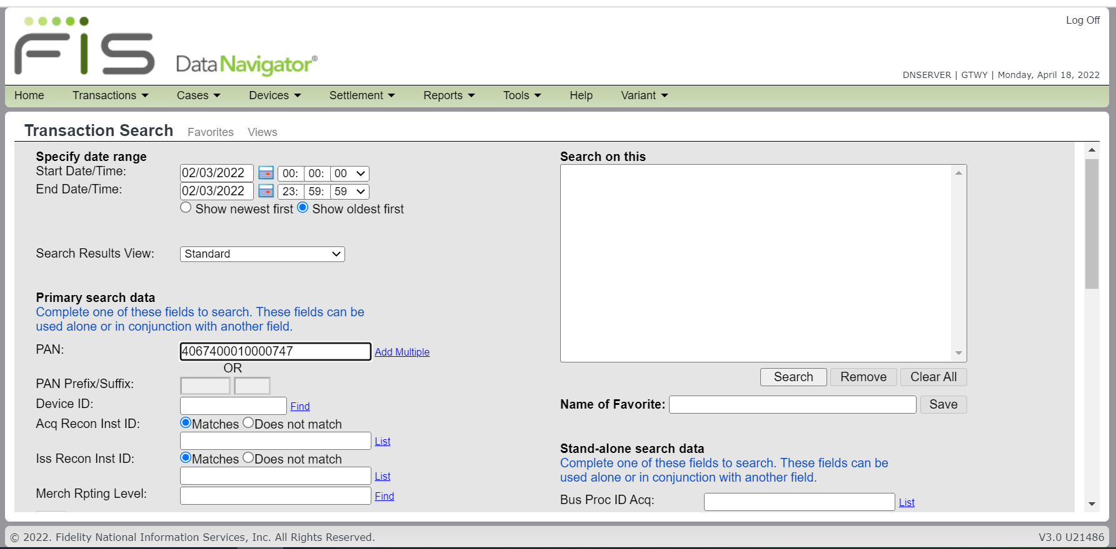

Slide 5
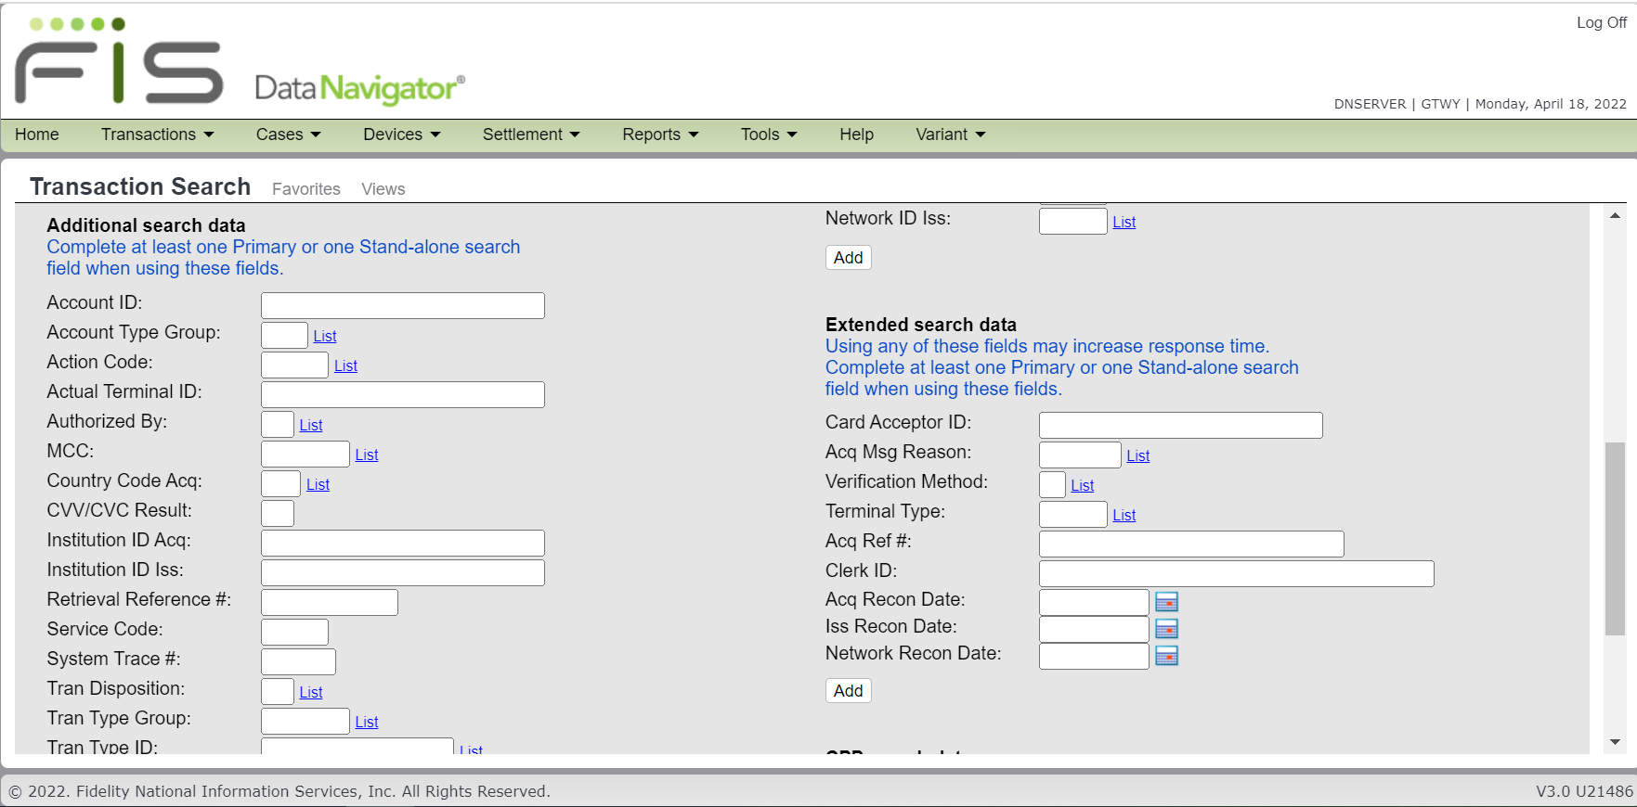

Slide 6
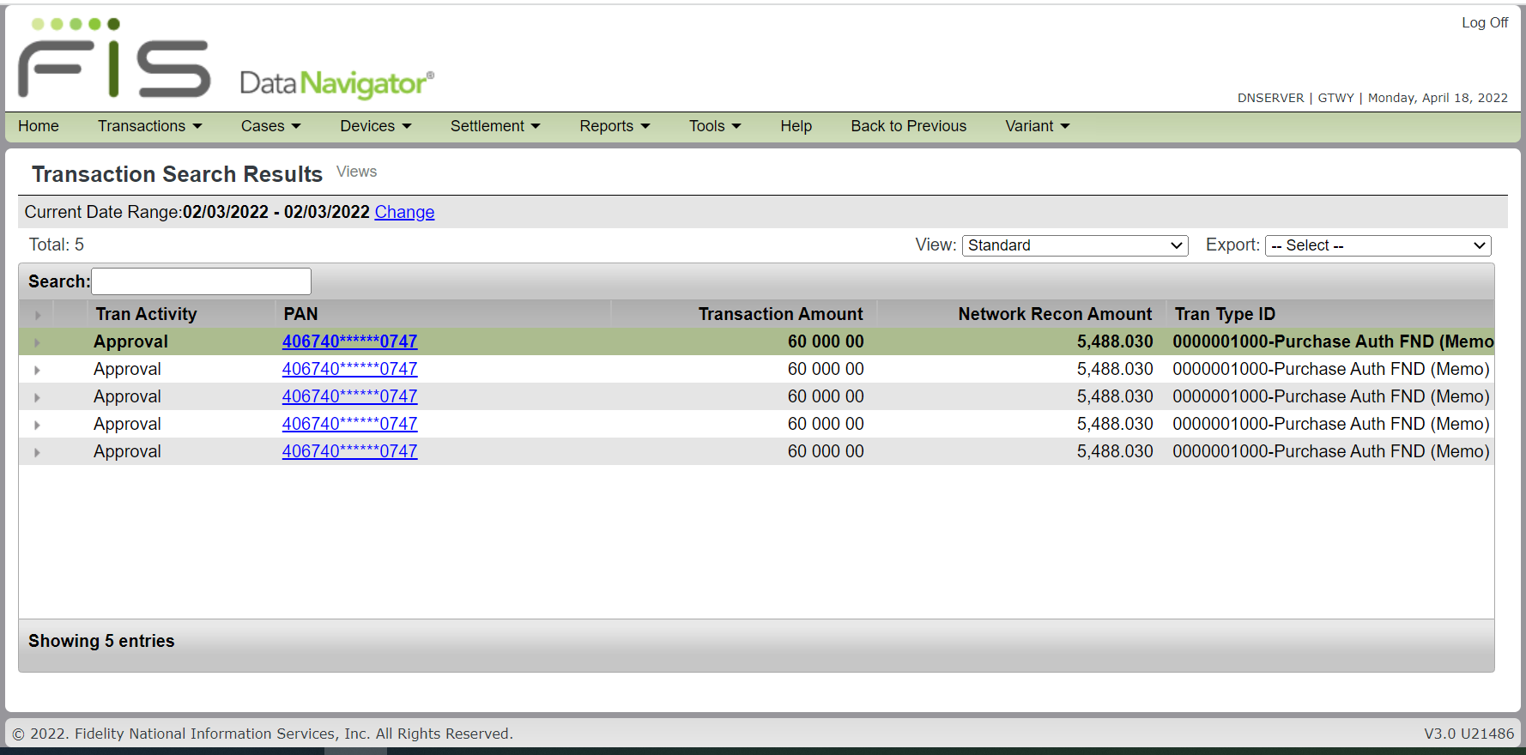

Slide 7
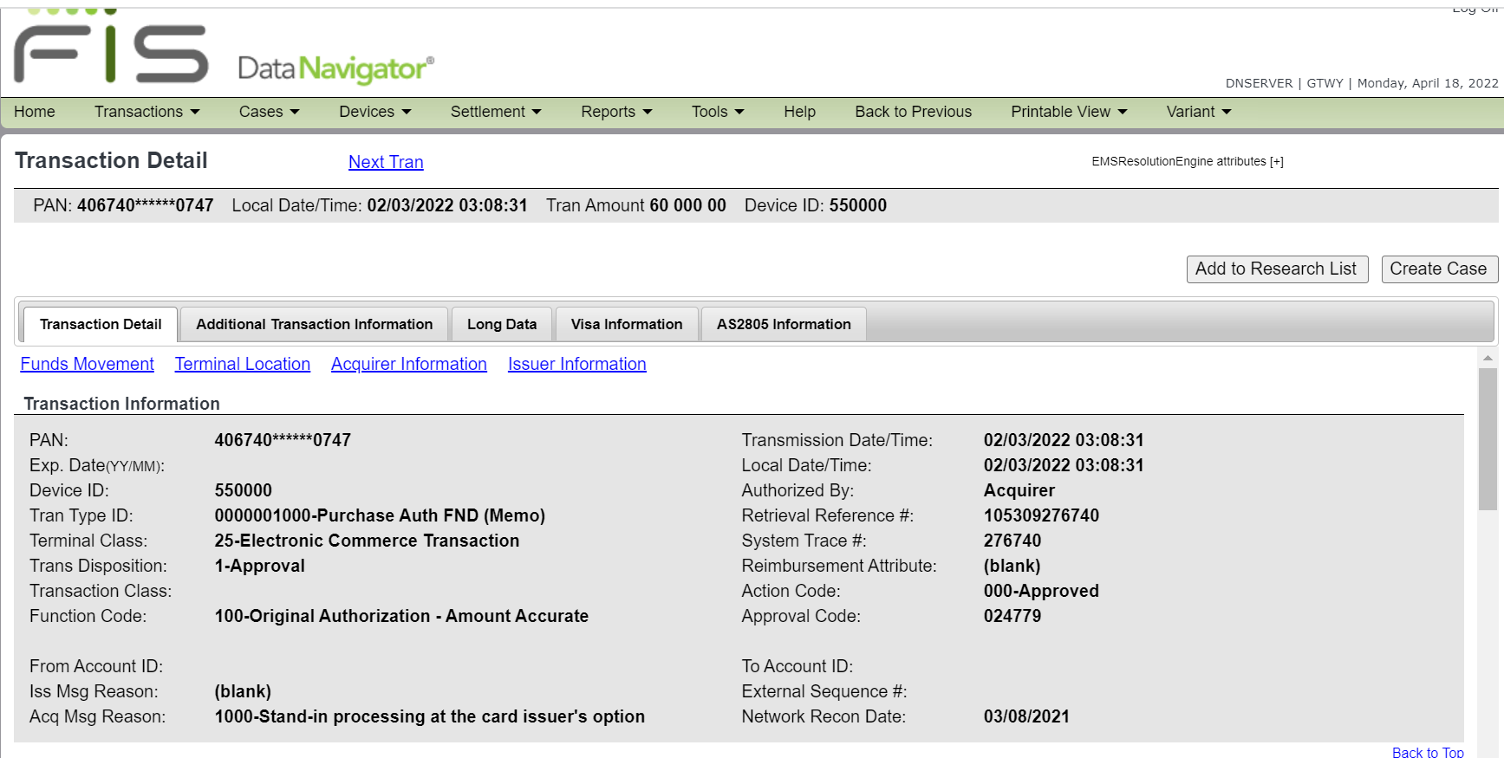

Slide 8
Communication between web and server
XML communication
Service name: XLTRAN
QXLTRAN: Request
RXLTRAN: Response

Slide 9
Request and response handling
WEB → CI01 task → QE01 task → CI01 task → WEB
API’s:
CXOPCI00.cpp
CXOPQE00.cpp
CXOSSX02.cpp
CXOSSX04.cpp
CXOSVC30.cpp

Slide 10
Thank you

